Slide 1
Cloud Computing
The Google File System

Slide 2
Definition -DFS
DFS: multiple users, multiple sites, and (possibly) distributed storage of files.
Benefits
  File sharing
  Uniform view of system from different clients
  Centralized administration
Goals of a distributed file system
  Network Transparency (access transparency)
  Availability- files should be easily and quickly accessible.

Slide 3
Architectures
Client-Server
  Traditional; e.g. Sun Microsystems Network File System (NFS)
  Cluster-Based Client-Server; e.g., Google File System (GFS)
Symmetric
  Fully decentralized; based on peer-to-peer technology
  e.g., Ivy (uses a Chord DHT approach)

Slide 4
Client-Server Architecture
One or more machines (file servers) manage the file system.
Files are stored on disks at the servers
Requests for file operations are made from clients to the servers.
Client-server systems centralize storage and management; P2P systems decentralize it.

Slide 5
cache
cache
client
client
Communication Network
cache
cache
Server
Disks
Server
Server
Architecture of a distributed file system: client-server model

Slide 6
Sun’s Network File System
Sun’s NFS for many years was the most widely used distributed file system.
  NFSv3: version three, used for many years
  NFSv4: introduced in 2003
    Version 4 made significant changes

Slide 7
Overview
NFS goals:
  Each file server presents a standard view of its local file system
  transparent access to remote files
  compatibility with multiple operating systems and platforms.
  easy crash recovery at server
Originally UNIX based; now available for most operating systems.
NFS communication protocols lets processes running in different environments share a file system.

Slide 8
NFS Implements Remote Access
File is moved to client
Client
Server
Client
Server
Requests from client
to access remote
file (with server
responses)
Client accesses
file
File stays
at server
File is returned
to the server
Remote Access Model
Upload/download model
e.g., FTP

Slide 9
Access Models
Most distributed file systems use the remote access model
  Client-side caching may be used to save time and network traffic
  Access is transparent to user; the interface resembles the interface to the local file system
FTP implements the upload/download model for read-write files.

Slide 10
NFS as a Stateless Server
NFS servers historically did not retain any information about past requests.
Consequence: crashes weren’t too painful
  If server crashed, it had no tables to rebuild – just reboot and go
Disadvantage: client has to maintain all state information; messages are longer than they would be otherwise.
NFSv4 is stateful

Slide 11
Advantages/Disadvantages
Stateless Servers
  Fault tolerant
  No open/close RPC required
  No need for server to waste time or space maintaining tables of state information
  Quick recovery from server crashes
Stateful Servers
  Messages to server are shorter (no need to transmit state information)
  Supports file locking
  Supports idempotency (don’t repeat actions if they have been done)

Slide 12
File System Model
NFS implements a file system model that is almost identical to a UNIX system.
  Files are structured as a sequence of bytes
  File system is hierarchically structured
  Supports hard links and symbolic links
  Implements most file operations that UNIX supports

Slide 13
Cluster-based or Clustered File System
A distributed file system that consists of several servers that share the responsibilities of the system, as opposed to a single server (possibly replicated).
The design decisions for a cluster-based systems are mostly related to how the data is distributed across the cluster and how it is managed.

Slide 14
Cluster-Based DFS
Some cluster-based systems organize the clusters in an application specific manner
For file systems used primarily for parallel applications, the data in a file might be striped across several servers so it can be read in parallel.
Or, it might make more sense to partition the file system itself – some portion of the total number of files are stored on each server.
For systems that process huge numbers of requests; e.g., large data centers, reliability and management issues take precedence.
  e.g., Google File System

Slide 15
Google File System (GFS) Concepts(Assumptions)
GFS uses a cluster-based approach implemented on ordinary commodity Linux boxes (not high-end servers).
Component failures are the norm rather than the exception.
    File System consists of hundreds or even thousands of storage machines built from inexpensive commodity parts.
  Files are Huge. Multi-GB Files are common.
    Each file typically contains many application objects such as web documents.
  Append, Append, Append.
    Most files are mutated by appending new data rather than overwriting existing data.
  Co-Designing
    Co-designing applications and file system API benefits overall system by increasing flexibility

Slide 16
The Google File System
GFS stores a huge number of files, totaling many terabytes of data
Individual file characteristics
  Very large, multiple gigabytes per file
  Files are updated by appending new entries to the end (faster than overwriting existing data)
  Files are virtually never modified (other than by appends) and virtually never deleted.
  Files are mostly read-only

Slide 17
Architecture
A GFS cluster consists of Single master & multiple chunkservers.
Files divided into fixed-size chunks (64MB).
  Immutable and globally unique 64 bit chunk handle assigned at creation
  Chunks stored by chunkservers on local disks as Linux files
  R or W chunk data specified by chunk handle and byte range
  Each chunk replicated on multiple chunkservers – default is 3
The master knows (more or less) where chunks are stored
  Maintains a mapping from file name to chunks & chunks to chunk servers
Clients contact the master to find where a particular chunk is located.

Slide 18
Architecture
Master maintains all file system metadata
  Namespace, access control info, mapping from files to chunks, location of chunks
  Controls garbage collection of chunks
  Communicates with each chunkserver through HeartBeat messages
  Clients interact with master for metadata, chunksevers do the rest, e.g. R/W on behalf of applications
Periodically the master polls all its chunk servers to find out which chunks each one stores
  This means the master doesn’t need to know each time a new server comes on board, when servers crash, etc.
Polling occurs often enough to guarantee that master’s information is “good enough”.

Slide 19
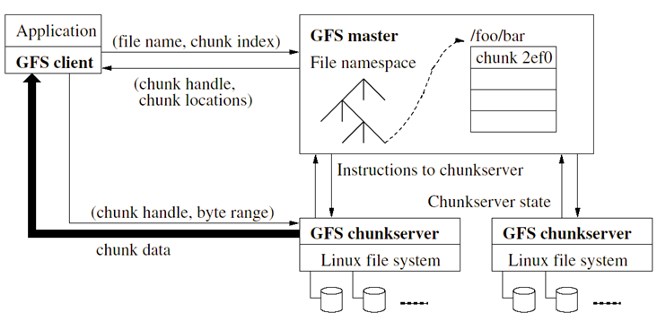
Architecture

Slide 20
Architecture
File name, chunk index
GFS client
Master
Contact address
Instructions
Chunk-server state
Chunk ID, range
Chunk server
Linux FS
Chunk Server
Linux FS
Chunk Server
Linux FS
Chunk data
The organization of a Google cluster of servers

Slide 21
Master
Single Master –
  Simplifies design
  Placement, replication decisions made with global knowledge
  Doesn’t R/W, so not a bottleneck
  Client asks master which chunkservers to contact

Slide 22
Client
Client translate file name/offset into chunk index within file
Send master request with file name/chunk index
Master replies with chunk handle and location of replicas
Client caches info using file name/chunk index as key
Client sends request to one of the replicas (closest)
Further reads of same chunk require no interaction
Can ask for multiple chunks in same request

Slide 23
Operation Log
Historical record of critical metadata changes
Log replicated on remote machines
Log kept small – checkpoint when > size
New checkpoint built without delaying mutations (takes about 1 min for 2 M files)
Only keep latest checkpoint and subsequent logs

Slide 24
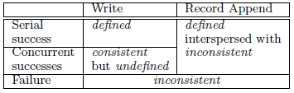
Consistency Model
Table 1: File Region State After Mutation
File namespace mutations are atomic
  Relatively simple, since just a single master.
Data mutations may be writes or record appends
Various file region states after mutations:
  Consistent - All clients see the same data, regardless of replicas
  Defined – Clients see what mutation writes in entirety
  Inconsistent – Different clients see different data

Slide 25
Leases and Mutation Order
A mutation is an operation that changes the contents or metadata of a chunk such as a write or an append operation. Each mutation is performed at all the chunk’s replicas.
We use leases to maintain a consistent mutation order across replicas.
The master grants a chunklease to one of the replicas, which we call the primary. The primary picks a serial order for all mutations to the chunk.
A lease has an initial timeoutof 60 seconds.

Slide 26
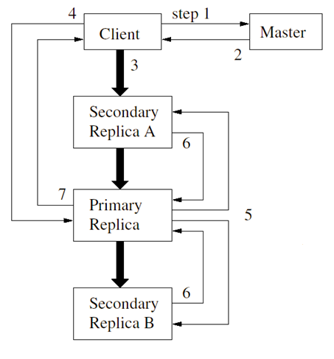
Control flow of a write operation
Client asks master for all replicas.
Master replies with primary and secondary. Client caches.
Client pushes the data to all replicas.
After all replicas acknowledge, client sends write request to primary.
Primary forwards write request to all replicas.
Secondaries reply to primary indicating operation completion.
Primary replies to client. Errors handled by retrying.

Slide 27
Data Flow
Fully utilize each machine’s network bandwidth
  Data pushed along chain chunkservers
Avoid bottlenecks and high-latency
  Machine forwards to closest machine in topology
Minimize latency
  Pipeline data transfer over TCP connections

Slide 28
Atomic Record Appends
Client pushes data to all replicas of last chunk of the file
Sends request to primary
Primary checks if will exceed 64MB, if so send message to retry on next chunk, else primary appends, tells 2ndary to write, send reply to client
If append fails, retries
  Replicas of same chunk may contain different data, including duplication of same record in part or whole
  Does not guarantee all replicas bytewise identical
  Guarantees data written at least once as atomic unit
  Data must have been written at same offset on all replicas of same chunk, but not same offset in file

Slide 29
Replica Placement
GFS cluster distributed across many machine racks
Need communication across several network switches
Challenge to distribute data
Chunk replica
  Maximize data reliability
  Maximize network bandwidth utilization
Spread replicas across racks (survive even if entire rack offline)

Slide 30
Creation, Re-replication, and Rebalancing
Replicas created for three reasons:
Creation
  Balance disk utilization
  Balance creation events
    After a creation, lots of traffic
  Spread replicas across racks
Re-replication
  Occurs when number of replicas falls below a watermark.
    Replica corrupted, chunkserver down, watermark increased.
  Replicate based on priority (fewest replicas)
  Rebalancing
  Periodically moves replicas for better disk space and load balancing
  Gradually fills up new chunkserver

Slide 31
Garbage Collection
Storage reclaimed lazily by GC.
File first renamed to a hidden name.
Hidden files removes if more than three days old.
When hidden file removed, in-memory metadata is removed.
Regularly scans chunk namespace, identifying orphaned chunks. These are removed.
Chunkservers periodically report chunks they have. If not “live”, master replies.

Slide 32
Fault Tolerance
Fast Recovery
  Master/chunkservers restore state and start in seconds regardless of how terminated
    Abnormal or normal
Chunk Replication

Slide 33
Shadow Master
Master Replication
  Replicated for reliability
  One master remains in charge of all mutations and background activities
  If fails, start instantly
  If machine or disk mails, monitor outside GFS starts new master with replicated log
  Clients only use canonical name of master

Slide 34
Shadow Master
Shadow Master
  Read-only access to file systems even when primary master down
  Not mirrors, so may lag primary slightly (fractions of second)
  Enhance read availability for files not actively mutated or if stale OK, e.g. metadata, access control info ???
  Shadow master read replica of operation log, applies same sequence of changes to data structures as the primary does
  Polls chunkserver at startup,monitors their status, etc.
  Depends only on primary for replica location updates

Slide 35
